Slide 1
Introduction to Cloud Computing
Cloud Computing in a Nutshell
Roots of Cloud Computing, Grid and Cloud
Layers and Types of Clouds
Service Models
Desired Features of a Cloud
Basic Principles of Cloud Computing
Challenges and Risks

Slide 2
Cloud Computing in a Nutshell
Computing - to be considered fully virtualized,
- must allow computers to be built from distributed components
- such as processing, storage, data, and software resources.
Technologies (cluster, grid, and now, cloud computing)
- all aimed at - access to large amounts of computing power
- fully virtualized manner,
- by aggregating resources and
- offering a single system view.
Important aim of these technologies - delivering computing as a utility.
Utility computing
- a business model for on-demand delivery of computing power;
- consumers pay providers based on usage (“pay as-you-go”),
- Ex: public utility services - water, electricity, gas, telephony.

Slide 3
The main principle behind Cloud computing model is offering computing, storage, and software “as a service.”
Buyya et al. [2]: “Cloud is a parallel and distributed computing system consisting of a collection of inter-connected and virtualised computers that are dynamically provisioned and presented as one or more unified computing resources based on service-level agreements (SLA) established through negotiation between the service provider and consumers.”
Vaquero et al. [3] have stated “clouds are a large pool of easily usable and accessible virtualized resources (such as hardware, development platforms and/or services).”
A report from the University of California Berkeley [5] summarized the key characteristics of cloud computing as: “(1) the illusion of infinite computing resources; (2) the elimination of an up-front commitment by cloud users; and (3) the ability to pay for use ... as needed ...”

Slide 4
The National Institute of Standards and Technology (NIST) [6] characterizes cloud computing as “... a pay-per-use model for enabling available, convenient, on-demand network access to a shared pool of configurable computing resources (e.g. networks, servers, storage, applications, services) that can be rapidly provisioned and released with minimal management effort or service provider interaction.”
Armbrust et al. [5] define cloud as the “data center hardware and software that provide services.”
Sotomayor et al. [7] point out that “cloud” is more often used to refer to the IT infrastructure deployed on an Infrastructure as a Service provider data center.
While there are countless other definitions, there seems to be common characteristics, which a cloud should have: (i) pay-per-use (no ongoing commitment, utility prices); (ii) elastic capacity and the illusion of infinite resources; (iii) self-service interface; and (iv) resources that are abstracted or virtualised.

Slide 5
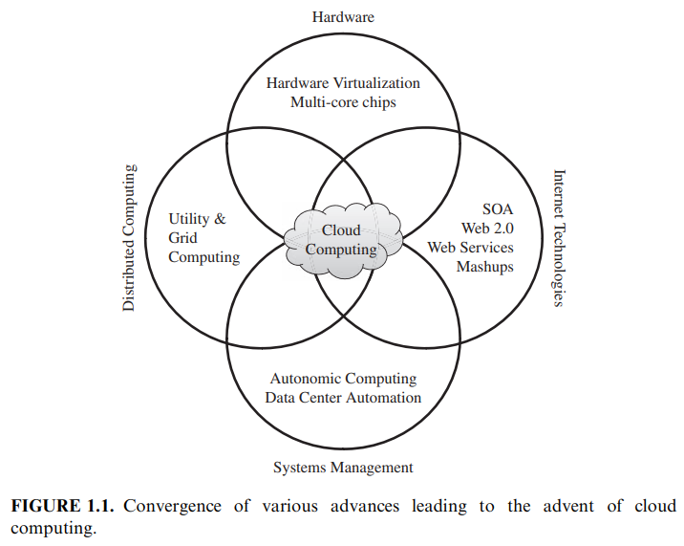
Roots of Cloud Computing
Roots of clouds computing - advancement of several technologies:
- hardware (virtualization, multi-core chips),
- Internet technologies
(Web services, service-oriented architectures, Web 2.0),
- distributed computing (clusters, grids), and
- systems management (autonomic computing, data center automation).
Figure 1.1 shows the convergence of technology fields that significantly advanced and contributed to the advent of cloud computing.

Slide 6
From Mainframes to Clouds
A switch in the IT world:
- in-house generated computing power to utility-supplied computing - resources delivered over the Internet as Web services.
Computing - delivered as a utility
This model - benefits to both consumers and providers of IT services.
Consumers:
- reduction on IT-related costs (cheaper services - external providers)
- opposed to heavy investments - IT infrastructure & personnel hiring.
Providers:
- achieve better operational costs;
- hardware and software infrastructures - serve many users,
- thus increasing efficiency
- leading to faster return on investment (ROI)
- lower total cost of ownership (TCO) .

Slide 7
SOA, Web Services, Web 2.0, and Mashups
The emergence of Web services (WS) open standards has significantly contributed to advances in the domain of software integration.
Web services can glue together:
- applications running on different messaging product platforms,
- enabling information from one application - available to others,
- enabling internal applications - available over the Internet.
WS standards
- created on top of existing ubiquitous technologies (HTTP, XML)
- providing a common mechanism for delivering services,
- for implementing a service-oriented architecture (SOA).

Slide 8
In a SOA, software resources are packaged as “services,”
- which are well-defined, self contained modules
- provide standard functionality and
- independent of the state or context of other services.
Services are described in a standard definition language.
In the consumer Web:
- information and services are aggregated,
- acting as building blocks of complex compositions,
- called service mashups.
Many service providers, such as Amazon, Facebook, and Google, make their service APIs publicly accessible using standard protocols such as SOAP and REST.

Slide 9
Grid Computing
Grid computing enables aggregation of distributed resources & transparently access to them.
A key aspect of the grid realization:
- building standard Web services-based protocols
- that allow distributed resources to be
“discovered, accessed, allocated, monitored, accounted for, and billed for, etc., and in general managed as a single virtual system.”
The Open Grid Services Architecture (OGSA)
- addresses this need for standardization
- by defining a set of core capabilities and behaviors
- that address key concerns in grid systems.

Slide 10
Globus Toolkit - a middleware - implements several standard Grid services.
However, ensuring QoS in grids - perceived as a difficult endeavor.
Lack of performance isolation - prevented grids adoption
(environments where resources are oversubscribed or
users are uncooperative).
Impossibility of enforcing QoS & guaranteeing execution time
- became a problem, especially for time-critical applications.
Another issue - that has lead to frustration when using grids
- availability of resources with diverse software configurations, including disparate operating systems, libraries, compilers, runtime environments, and so forth.
Virtualization technology has been identified as the perfect fit to issues that have caused frustration when using grids.

Slide 11
Utility Computing
In utility computing environments:
- users assign a “utility” value to their jobs,
- where utility is a fixed or time-varying valuation
- that captures various QoS constraints
(deadline, importance, satisfaction).
The valuation is the amount they are willing to pay a service provider to satisfy their demands.
The service providers then attempt to maximize their own utility, where said utility may directly correlate with their profit.
Providers can choose to prioritize high yield user jobs,
- leading to a scenario where shared systems - viewed as a marketplace,
- where users compete for resources based on perceived utility.

Slide 12
Hardware Virtualization
Cloud computing services - backed by large-scale data centers (composed of thousands of computers).
Such data centers are built - to serve many users and host many disparate applications.
For this purpose, hardware virtualization can be considered as a perfect fit to overcome most operational issues of data center building and maintenance.
As depicted in Figure 1.2, a software layer, the virtual machine monitor (VMM), also called a hypervisor, mediates access to the physical hardware presenting to each guest operating system a virtual machine (VM), which is a set of virtual platform interfaces [22].

Slide 13
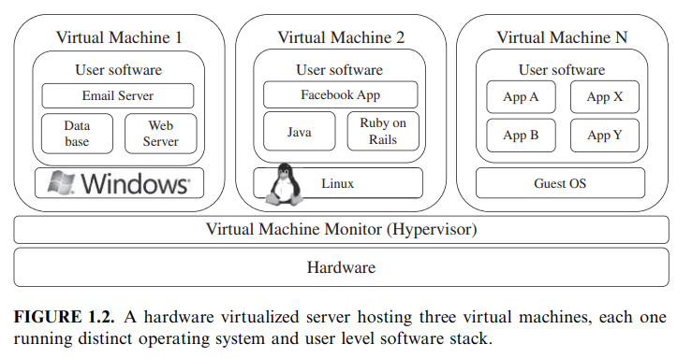

Slide 14
With adoption of virtualization - three basic capabilities regarding management of workload in a virtualized system are:
- isolation, consolidation, and migration.
Workload isolation is achieved - all program instructions are fully confined inside a VM, which leads to improvements in security.
Better reliability - because software failures inside one VM do not affect others.
Better performance control - since execution of one VM should not affect the performance of another VM.
Consolidation of several individual and heterogeneous workloads onto a single physical platform - leads to better system utilization.
Workload migration - targets at facilitating hardware maintenance, load balancing, and disaster recovery.
A number of VMM platforms exist that are the basis of many utility or cloud computing environments. The most notable are: VMWare, Xen, and KVM.

Slide 15
Virtual Appliances and the Open Virtualization Format
Virtual appliance - an application combined with environment needed to run it (OS, libraries, compilers, databases, application containers etc)
On-line marketplaces - allow the exchange of ready-made appliances - both commercial and open-source.
VMWare virtual appliance marketplace - allows users to deploy appliances on VMWare hypervisors or on partners public clouds
Amazon allows developers to share specialized Amazon Machine Images (AMI) and monetize their usage on Amazon EC2.
In order to facilitate packing and distribution of software to be run on VMs several vendors (Ex: VMware, IBM, Citrix, Cisco, Microsoft, Dell, HP) - devised the Open Virtualization Format (OVF).
An OVF package consists of a file, or set of files, describing the VM hardware characteristics (e.g., memory, network cards, and disks), operating system details, startup, and shutdown actions, the virtual disks themselves, and other metadata containing product and licensing information.

Slide 16
Autonomic Computing
Autonomic computing - seeks to improve systems by decreasing human involvement in their operation. i.e., systems should manage themselves, with high-level guidance from humans.
Autonomic systems - rely on monitoring probes and gauges (sensors), - computing optimizations based on monitoring data, and on effectors to carry out changes on the system.
IBM’s Autonomic Computing Initiative - define the four properties of autonomic systems: self-configuration, self optimization, self-healing, and self-protection.
Concepts of autonomic computing inspire software technologies for data center automation, which may perform tasks such as:
- management of service levels of running applications;
- management of data center capacity;
- proactive disaster recovery; and
- automation of VM provisioning.

Slide 17
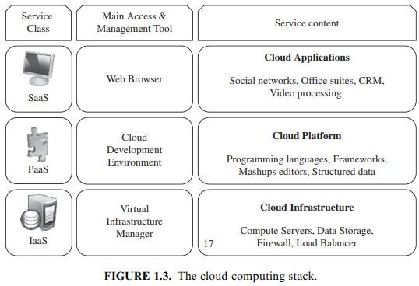
Layers and Types of Clouds
Cloud computing services are divided into three classes:
(1) Infrastructure as a Service
(2) Platform as a Service, and
(3) Software as a Service.

Slide 18
Figure 1.3 depicts the layered organization of the cloud stack from physical infrastructure to applications.
Abstraction levels - viewed as a layered architecture
- services of a higher layer can be composed from services of the underlying layer.
Core middleware:
- manages physical resources & VMs deployed on top of them;
- provides required features (multi-tenant & pay-as-you-go services)
Cloud development environments:
- built on top of infrastructure services
- to offer application development & deployment capabilities
Once deployed in the cloud - applications can be consumed by end users.

Slide 19
Infrastructure as a Service
Infrastructure as a Service (IaaS) - offers virtualized resources on demand.
(computation, storage, and communication)
A cloud infrastructure - enables on-demand provisioning of servers.
Amazon Web Services mainly offers IaaS - EC2 service
- means offering VMs with a software stack that can be customized
- similar to how an ordinary physical server would be customized.
Users are given privileges - numerous activities to the server:
- starting and stopping it,
- customizing it by installing software packages,
- attaching virtual disks to it, and
- configuring access permissions and firewalls rules.

Slide 20
Platform as a Service
Platform as a Service (PaaS) - offers a higher level of abstraction to make a cloud easily programmable.
A cloud platform - offers an environment
- on which developers create & deploy applications
- and do not need to know how many processors or how much memory that applications will be using.
Google AppEngine - an example of Platform as a Service offers:
- a scalable environment
- for developing and hosting Web applications,

Slide 21
Software as a Service
Software as a Service (SaaS) - Applications reside on the top of the cloud stack.
SaaS –
- alleviates the burden of software maintenance for customers &
- simplifies development and testing for providers
Services provided by this layer - accessed by end users (Web portals)
Thus, consumers are increasingly shifting from locally installed computer programs to on-line software services that offer the same functionally.
Salesforce.com - which relies on the SaaS model
- offers business productivity applications - reside completely on their servers,
- allowing costumers to customize & access applications on demand.

Slide 22
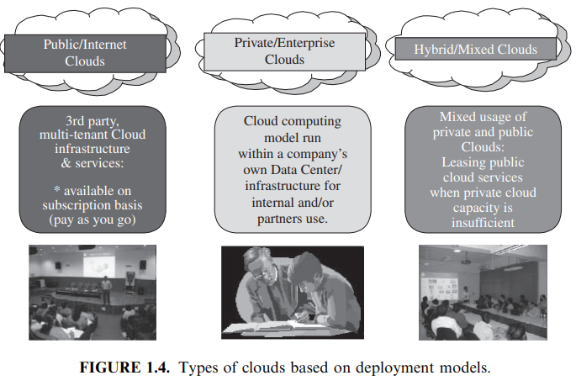
Deployment Models
A cloud can be classified as public, private, community, or hybrid based on model of deployment as shown in Figure 1.4.

Slide 23
Armbrust et al. defines:
public cloud - a “cloud made available in a pay-as-you-go manner to the general public” and
private cloud - “internal data center of a business or other organization, not made available to the general public.”
Mostly, establishing a private cloud means restructuring an existing infrastructure by adding virtualization and cloud-like interfaces.
Community cloud - “shared by several organizations and supports a specific community that has shared concerns (e.g., mission, security requirements, policy, and compliance considerations).”
Hybrid cloud - when a private cloud is supplemented with computing capacity from public clouds.
Cloud-bursting -temporarily renting capacity to handle spikes in load.

Slide 24
Desired features of a Cloud
Essential features of a cloud are: (i) self-service, (ii) per-usage metered and billed, (iii) elastic, and (iv) customizable.
Self-Service:
- Consumers of cloud computing services expect on-demand, nearly instant access to resources.
- To support this - clouds must allow self-service access
- so that customers can request, customize, pay & use services
- without intervention of human operators.
Per-Usage Metering and Billing:
- Cloud computing eliminates up-front commitment by users & allow them to request and use only necessary amount.
- Services must be priced on a short term basis allowing users to release resources as soon as they are not needed.

Slide 25
For these reasons, clouds must implement features to allow efficient trading of service such as pricing, accounting, and billing.
Metering should be done accordingly for different types of service & and usage promptly, thus providing greater transparency.
Elasticity:
- Cloud computing gives the illusion of infinite computing resources available on demand.
- Thus users expect clouds to rapidly provide resources in any quantity at any time.
Customization:
- In a multi-tenant cloud a great disparity between user needs is often the case.
- Thus, resources rented from the cloud must be highly customizable.

Slide 26
Basic Principles of Cloud Computing
Federation:
- Cloud service providers must be capable of collaborating and resource sharing at any point irrespective of their type.
- usually needed when an organization extends its computing paradigm from the private to the public cloud.
- federation must be kept transparent & carried out in a secure and independent way.
Independence:
- user of cloud computing services must be independent of the provider’s specific tool & type of service.
Isolation:
- service provider must ensure the user with respect to the isolation of their data from others.
- data in the same cloud must be separated from different users and therefore should not be accessed.

Slide 27
Elasticity:
- user of cloud computing must be provided with ease of accessing and releasing the resources as required.
- rules associated with elasticity must be included within the contract made between consumers & services providers.
Business Orientation:
- To develop a more efficient computing environment, an efficient platform must be developed before the applications are included in the cloud.
- This typically ensures the quality of services and assist SLA (Service-Level-Agreement).
Trust:
- To build a successful cloud computing environment, one of the major factors is trust between consumers and service providers. - Therefore, effective mechanisms must be included to develop a trustworthy computing environment.

Slide 28
Challenges and Risks
Security, Privacy, and Trust
Information security is a main issue: “current cloud offerings are essentially public ... exposing the system to more attacks.”
Potentially additional challenges to make cloud computing environments as secure as in-house IT systems.
Security and privacy affect the entire cloud computing stack, since there is a massive use of third-party services and infrastructures that are used to host important data or to perform critical operations.
Legal and regulatory issues also need attention.
Physical location of data centers determines the set of laws that can be applied to the management of data.
For example, specific cryptography techniques could not be used because they are not allowed in some countries.

Slide 29
Data Lock-In and Standardization
A major concern of cloud computing users is - having their data locked-in by a certain provider.
Users may want to move data and applications out from a provider that does not meet their requirements.
However, in their current form, cloud computing infrastructures and platforms do not interoperate and user data are not portable.
The answer to this concern is standardization. In this direction, there are efforts to create open standards for cloud computing.
Cloud Computing Interoperability Forum (CCIF)
- “enable a global cloud computing ecosystem whereby organizations are able to seamlessly work together for the purposes for wider industry adoption of cloud computing technology.”
Unified Cloud Interface (UCI) by CCIF
- aims at creating a standard programmatic point of access to an entire cloud infrastructure.

Slide 30
Availability, Fault-Tolerance, Disaster Recovery
Users will have certain expectations about the service level to be provided once their applications are moved to the cloud.
These expectations include availability of the service, its overall performance, and what measures are to be taken when something goes wrong in the system or its components.
SLAs, which include QoS requirements, must be ideally set up between customers & cloud computing providers.
An SLA specifies the details of the service to be provided, including availability and performance guarantees.
Additionally, metrics must be agreed upon by all parties, and penalties for violating the expectations must also be approved.

Slide 31
Resource Management and Energy-Efficiency
One important challenge faced by providers of cloud computing services is the efficient management of virtualized resource pools.
Physical resources such as CPU cores, disk space, and network bandwidth must be sliced and shared among virtual machines running potentially heterogeneous workloads.
Dimensions to be considered include: number of CPUs, amount of memory, size of virtual disks, and network bandwidth.
Dynamic VM mapping policies may leverage the ability to suspend, migrate, and resume VMs as an easy way of preempting low-priority allocations in favor of higher-priority ones.
Migration of VMs also brings additional challenges such as detecting when to initiate a migration, which VM to migrate, and where to migrate.
Data centers consumer large amounts of electricity. Besides the monetary cost, data centers significantly impact the environment in terms of CO2 emissions from the cooling systems.

